Slide 1
Gallery Walk Instructions
Please take some time and share your input and ideas, responding to the questions posted around the room.
Please write down your answers on the post-it notes provided and stick them on the corresponding sheets.

Slide 2
Discovering Your Role in Disrupting Racial Inequity

Slide 3
Gallery Walk Debrief
Introduce concept
Present feedback learned from the listening sessions
Notes:
Phylicia
Introduce yourself as part of the CT Collaborative for Race Equity project. As Monique will talk about shortly, the collaborative was charged with creating a race equity framework for CT’s homeless and housing system.
The Gallery Walk you just participated in was a component of the community listening sessions we conducted to learn about the experiences of BIPOC with lived experience of homelessness and those currently providing housing and homeless services Connecticut.
During the gallery walk portion, questions were posted on the walls for participant response during the first 30 minutes of the listening session. The gallery walk asked participants to reflect on and answer eight questions based on their experiences as BIPoC and as someone who engaged or is currently part of the housing and homeless system.
Share what we learned/present responses

Slide 4
Welcome, Introductions, Objectives
Phylicia Adams, Stonington Housing Authority
Tashmia Bryant, CCEH
Fionnuala Darby-Hudgens, CT Fair Housing Center
Jessica Park, CSH
Monique Price-Taylor, CSH
Notes:
Jess
Welcome
Introductions (have people introduce themselves?)

Slide 5
Equity in Practice Guidelines
“Try On”
Experience Discomfort
Move up, Move up
Be aware of Intent & Impact
Practice Both/And thinking
Notice Content AND

Slide 6
CT Collaborative for Race Equity
Notes:
Monique

Slide 7
CT Race Equity Framework Process
Part 1: Racism/Race Equity 101
Part 2: Intersection of Race & Homelessness
Part 3: CT Data
Notes:
Monique
CT Collaborative for RE- A collective learning, listening, and design process to build a race equity framework to advance equitable access to housing resources and services for homeless and high need individuals and families throughout the state of Connecticut. SH brought together a cohort individuals interested in advancing racial equity to co-create, in community, a race equity framework for use by CT continuum of housing resources.
The goal was to:
Create and support advocates/champions for race equity to lead culture change in their organization, communities, and systems
Identify next steps to advance race equity across organizations, communities, and larger systems
Three phase process
This framework was codesigned using a co-creation management strategy different parties together to jointly produce a mutually valued outcome in this case the framework.
Three part learning to gain deeper understanding of the many dimensions of historic racism and how it manifests in our lives, service and housing systems
Part 1 The Learning Series partnered with agencies RE-CEenter
statewide leader on the integration of race equity in systems change. This session introduced common language around issues of power, privilege, oppression, prejudice, race and racism. This interactive training allowed space for participants to examine their own individual experiences of socialization and identity development. Participants were also introduced to a set of practice guidelines to utilize when working from an equity lens.
Part 2 Community Listening Sessions "Nothing about us without us"
In order to create this framework, we conducted several listening sessions across Connecticut to hear directly from Black, Indigenous, and People of Color (BIPoC) who either have lived experience of homelessness and/or currently providing services in supportive housing or organizations working to alleviate homelessness in Connecticut.
The community listening sessions were intentionally designed to center the voices of BIPOC, as such were exclusive to BIPOC with lived experience of homelessness and BIPOC in service positions. The objectives were to grow our insights and collect in qualitative data around the following
Key challenges that contribute to the overrepresentation of BIPOC among the population experiencing homelessness
Unique barriers faced by BIPOC experiencing homelessness
Programs and interventions that are and are not working well
Part 3 Co-Design
CSH partnered with Design Impact (DI), a social innovation organization, to lead the cohort through a DI used human centered design as a framework for codesign. The inclusive nature of HCD engages the voices that are often left out of decision making, thereby democratizing the design process and allowing the unique perspectives of multiple stakeholders to reflect in the end deliverable.
These three steps helped us to get to the following themes and recommendations.

Slide 8
Race Equity Themes and Recommendations
Race
Equity is
A Process
Representative Leadership
Pathways to Resources
Safe Space for My Race
Building Racial Transformers
Notes:
Monique
Themes & Recommendations
Representative Leadership:
Retool Recruitment/ Promotion Practice: Concerted and targeted efforts within recruitment, hiring and promotion practices to achieve RE in homeless sector.
Create and Maintain Race Equity Culture: inclusive culture for People of Color to fully express creative selves to retain and recognize POC contributions creating social impact
Pathways to Resources:
RE Collective Impact Efforts: cross sector collaboration to collectively impact to end racial disparity in homelessness. Funding Demonstration for Homeless Prevention: prioritizing people of color in prevention services funding would provide equitable access, and address emerging trends in homelessness
Safe Space for My Race
Develop Restorative Justice Practice- theory of practice that emphasizes repairing harm caused by behavior to transform people, relationships and communities
RE Evaluation or Certification Program: Agencies serving POC experiencing homelessness establish practices and policies to address racial disparity- focus on racial bias, restorative justice circles
Building Racial Transformers
Develop RE Toolkit-create inclusive programs and systems or POC with training modules for agencies and those receiving services. Centering the voice of POC, agencies that implement can be eligible for RE Certification.
Establish a RE Peer Network: Establish a RE Peer Network: The racial equity peer network can be a platform for identifying internalized oppression among staff and those receiving services and provide support and dismantle inequities that exist in service delivery.

Slide 9
Setting the Stage
How racism is evident in policies, practices, and systems
Notes:
Jess

Slide 10
Housing Discrimination & Housing Policy
@ctfairhousing
Fionnuala Darby-Hudgens, MPA
September 2019

Slide 11
About Us
The mission of the Connecticut Fair Housing Center is to ensure that all people have equal access to housing opportunities in Connecticut.
Because housing discrimination disproportionately affects people with low incomes, the Center focuses on the intersection of poverty and housing discrimination. The Center also assists Connecticut homeowners who have been hardest by the nation’s ongoing foreclosure crisis.

Slide 12
Federal & State Fair Housing Act
In order to make sure everyone has equal access to housing, Congress passed the Fair Housing Act of 1968. It prohibits discrimination concerning the rental, sale or financing of housing because of you’re your membership in a protected class.
Connecticut has protected vulnerable members of our communities by enacting additional state-wide fair housing laws.
Notes:
EVERY COVERED DWELLING

Slide 13
Federal & State Fair Housing Protections
Federal
State
Race
Color
National Origin
Sex
Disability
Religion
Familial Status
Ancestry
Marital Status
Age
Sexual Orientation
Lawful Source of Income
Gender Identity & Expression
Veteran Status

Slide 14
What is housing discrimination?

Slide 15
Identifying Housing Discrimination
Misrepresenting the availability of housing
Refusal to rent or sell
Discrimination in terms and conditions
Discriminatory advertising
Use of threats or coercion
Discrimination with a smile

Slide 16
Housing Discrimination
Housing discrimination is still a problem, fair housing groups across the country receive more than 25,000 calls every year alleging housing discrimination
CFHC receives over 1,500 calls a year
The United States and Connecticut remain highly segregated 67% of State’s population of color lives in 8% of Connecticut’s towns

Slide 17
Segregation Map of Connecticut

Slide 18
How did we get here?

Slide 19
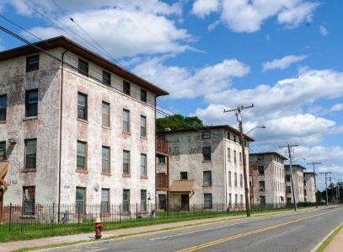
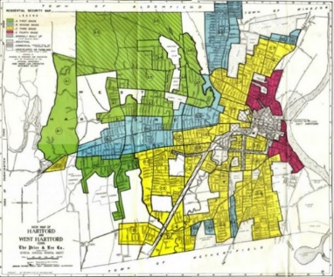
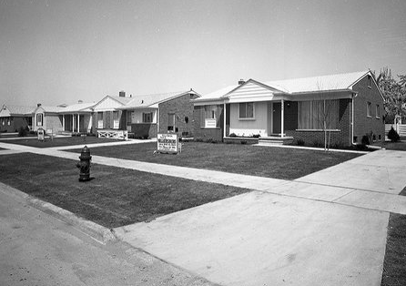
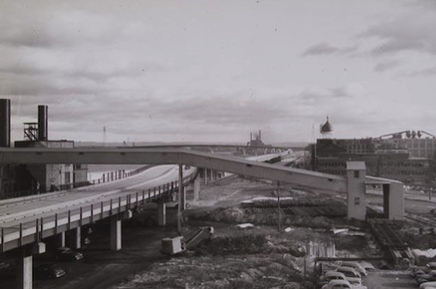
The Path of Discriminatory Policies
Our cities and towns in the northeast were predominately developed in response to migration patterns.
Two major population surges post WWI and post WWII
Logically when you have an influx of people, you need housing, but where you put housing, and who gets to live there shapes out communities.
Worker housing built before and during the industrial revolution often excluded non-white workers.
Colt Factory housing built in 1910.
To protect the real estate during the great depression the Federal Housing Administration created the Home Owners Loan Corporation, which assessed the risk of lending in neighborhoods. Non-white and non Christian neighborhoods were downgraded or “redlined.”
Post WWII developed was heavily subsidized with federal money, and often excluded non-white families from homeownership. Non-white servicemen could not access the inexpensive G.I. Bill mortgages offered to veterans.
Simultaneously, highway development and urban renewal decimated non-white urban neighborhoods.

Slide 20
How a perfect storm is created…

Slide 21
Constitution Plaza, Hartford, Connecticut
“What went wrong with Constitution Plaza? Did sensible people really mean to build a sterile, 9-5 suburban-style office park mostly disconnected from the downtown it was supposed to revive? Well, no. The project was supposed to be connected to Main Street by a pedestrian ramp. It was supposed to have housing. It was supposed to generate economic activity in surrounding blocks. But none of that happened.” Tom Condon, Hartford Courant, 9/9/2002

Slide 22
We built our segregated environment with decades of discriminatory policy.

Slide 23
Segregation Map of Connecticut

Slide 24
Housing Discrimination, Poverty Concentration & Increased Housing Demand
The most frequent housing discrimination reported is against individuals with physical or mental disabilities, and against families with children.
Limited affordable housing
& Disability Discrimination
Need for more housing to prevent homelessness
Limited affordable housing
& Source of Income Discrimination
Need for more housing to prevent homelessness
Limited affordable housing
Eviction & Criminal Backgrounds
Need for more housing to prevent homelessness

Slide 25
What can we do?

Slide 26
Racial Disparities in Housing and Homelessness
Tashmia Bryant
Training and Technical Assistance Coordinator

Slide 27
System Level

Slide 28
Poverty
Criminal Justice
Education
Housing
Healthcare
Notes:
The United States’ prison population has reached 2.2 million people, and has increased 500 percent over the past 40 years without a corresponding increase in crime.
The United States incarcerates more people per capita than any other nation.

Slide 29
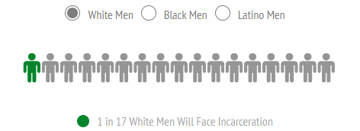
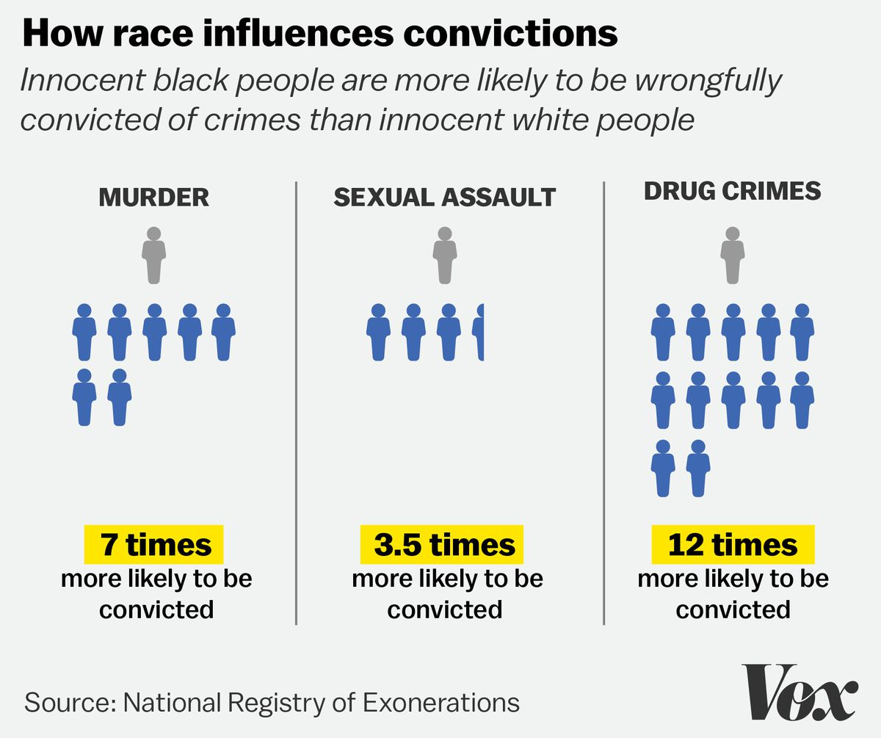
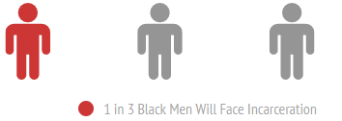
Criminal Justice
Notes:
Homelessness rate highest for black women, over 45, incarcerated more than once and have been released for less than 2 years

Slide 30
Deprivation as a Result of Stigma
A criminal record can reduce the likelihood of a callback or job offer by nearly 50 percent.
Only 55% of formerly incarcerated people (FIP) are able to obtain a job the first year after incarceration
13 % of Black men have lost their right to vote, which is 7x the national average
A survey study found that 43% of property managers would reject someone with a criminal record
Notes:
Upon re-entry in to society, a criminal record can create a number barriers to a productive life
Of those who do obtain jobs, the median annual earnings are $10,090 (Looney & Turner, 2018). The federal poverty level is $12,140 for a household with one person and increases for families with more people.
NAEH estimated that almost 50,000 people a year enter homeless shelters immediately after exiting incarceration

Slide 31
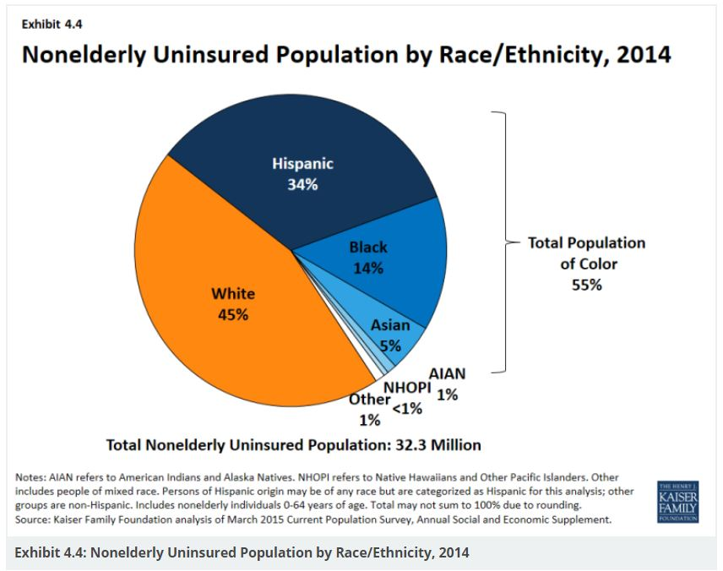
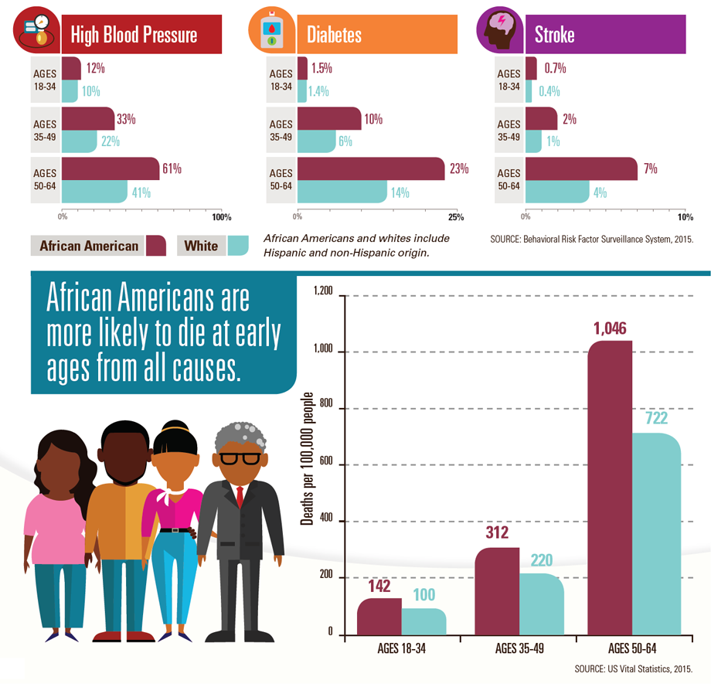
Lower frequency of use of evidence-based practices and poorer quality of care
Link to study
Higher negative health outcomes
Barriers to housing due to health issues
Health Disparities
Racial Disparities in People Experiencing Homelessness

Slide 32
Disparities in Education
Notes:
1 - The highest poverty districts in our country receive about $1,000 less per student than the lowest poverty districts (The Education Trust, 2018)
2 - Non-black teachers have significantly lower educational expectations for black students than black teachers do when evaluating the same students. (Brookings, 2015)
The finding that student-teacher racial mismatch affects teachers’ expectations for students’ educational attainment is consistent with existing evidence that indicates student-teacher racial mismatch directly affects student achievement
A 2011 report estimated over 40 percent of public schools (nationally) do not employ a single teacher of color (Brookings, 2011)
3 - Student-teacher mismatch disproportionately and negatively impacts students of color and their ability to receive an adequate and fair education
This impacts students in the long run with regard to income. Brings us back to the conversation of poverty.
Bachelor’s degree holders earn average of 1.6 times more than those with a high school degree only
Bachelor’s degree holders earn average of 2.3 times more than those with less than a high school degree

Slide 33
Organization Level

Slide 34
Absence of Cultural Responsiveness
Systems of service are designed and determine client eligibility
End-user must fit the program
Infrequent and spaced survey periods
Is feedback actually implemented?
Diversity
One lived experience representative on your board
Diversity primarily at junior-level
One-time racial equity evaluation (if at all)
Notes:
CT- Youth Action Hub
Does outreach, advocacy, and training
Is part of Collaboratives and work groups

Slide 35
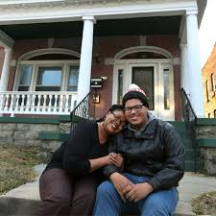
Does the environment represent equity?
Notes:
The images at the bottom of the slides are similar to those standardly used in advertisements for family related programs/services, medication advertisements, therapy advertisements. They might be seen on commercials or in flyers or posted in an office. The key element missing is diversity. When people can relate to the
Are there visible signs of your organization’s commitment to racial equity in your primary physical location, e.g. signage that states your commitment and/or physical representation of diverse communities?
Do you encourage or support difficult conversations about race in a safe, confidential, private space?
Are organizational materials assessed for racial bias and reviewed to ensure reflection of your community’s diversity?

Slide 36
Individual Level

Slide 37
Bias
Explicit Bias
“Explicit bias” refers to the attitudes and beliefs we have about a person or group on a conscious level.
Implicit Bias
Attitudes towards people or associate stereotypes with them without our conscious knowledge
Interpersonal and Intrapersonal
Implicit Bias test:
https://implicit.harvard.edu/implicit/
Notes:
Explicit bias:
Expressions of explicit of bias (discrimination, hate speech, etc.) occur as the result of deliberate thought. Thus, they can be consciously regulated.
People are more motivated to control their biases if there are social norms in place which dictate that prejudice is not socially acceptable.
intergroup contact between people of different races can increase trust and reduce the anxiety that underlies bias.
https://perception.org/research/explicit-bias/
Implicit bias:
media and culture makers have a role to play by ceasing to perpetuate stereotypes in news and popular culture
Instituting specific procedures of decision making and encouraging people to be mindful of the risks of implicit bias can help us avoid acting according to biases that are contrary to our conscious values and beliefs.

Slide 38
Need for Culturally Responsive Service Provision
Dysfunctional Rescuing
Bucket solutions
Labeling
Triggering
Prescriptive

Slide 39
Training and Conversations on Race
Name Race
How, specifically, does race play into our work?
Vocabulary
Develop competency on aspects of racial equity
History
Impact of systemic racism on housing/homelessness
Notes:
After you’ve collected your data, you have to discuss what this means, figure out why these outcomes are the way they are, and develop a plan to address them
- You can’t effectively do this without understanding of the root cause and the accurate language to discuss it.

Slide 40
Understanding Your Role and Strategies to Act
Notes:
Jess

Slide 41
Group Brainstorming Activity (Remember Equity in Practice Guidelines)
What are some strategies for disrupting racism at the individual, organizational, or system/policy level? (10 minutes)
What are the gaps/needs in your individual, organizational, or policy toolkit that need to be addressed? (10 minutes)
Report backs (10 minutes)
Notes:
Jess
30 minutes total
Set-Up:
Get into groups based on your row. Facilitators help.
Group 1 and 4: Individual
Group 2 and 5: Organizational
Group 3 and 6: Community/Policy
2. Each group is charged with answering Q1 (10 minutes) and Q2 (10 minutes) for assigned level only
3. Each group has a facilitator/scribe/timekeeper: P, M, M, K, J, F/C?
4. Each group selects a person to share ONE strategy and ONE gap/need (10 minutes)

Slide 42
Let’s Reflect
What is 1 way you are committing to disrupt racial inequity moving forward?
Notes:
Monique

Slide 43
Contact Information
Phylicia Adams
Executive Director
Stonington Housing Authority
padams@stoningtonha.org
Kyle Barrette
Program Manager
CSH
kyle.barrette@csh.org
Tashmia Bryant
Training & Technical Assistance Coordinator
CCEH
Tbryant@cceh.org
Fionnuala Darby-Hudgens
Director of Operations
CT Fair Housing Center
finn@ctfairhousing.org
Jessica Park
Program Manager
CSH
jessica.park@csh.org
Monique Price-Taylor
Program Manager
CSH
monique.price@csh.org

